Slide 1

A Project in Web Music Player
“GET THE BEAT”
Submitted by Asst.Prof
Govind Singh Mehta (19224512029) Kavita Dangwal
Aman Singh Negi (19224512020)
Pradoon Bhagat (192245 12036)

Slide 2
Web Music Player “Get the Beat”
We would like to offer you a stylish and reasonable presentation .

Slide 3
Project Goal
“Get the Beat” under the category of “MUSIC PLAYER APP” a Web based project.
The main highlight of the project is to make the proposed become a high learnability webplayer without too many complex features, enhance the interaction between the user and the media control so that the user can have a better experience to achieve real pressure relief.
The biggest difference between the music player and existing applications is that it is completely free for users to use.

Slide 4
Functions
01 Simple User Interface
02 Able to play audio files smoothly
03 Choose your fav music from Playlist
04 Add music in Playlist
04 Play and Pause Buttons
05 Able to drag music forward or backward through timeline
06 Play music in a loop
07 Change music by clicking on Next Button

Slide 5
Languages used for Development
HTML - For front end and basically for text related work.
CSS - CSS is use for styling of Web Page.
Java Script - Java Script is used for backend and basically for logic related work.

Slide 6
Tools to Use
1. Software Requirement
A. Visual Studio Code
B. Google Chrome Browser
2. Hardware Requirement
A Laptop
- Processor: Intel(R) Core(TM) i7-4500U CPU @ 1.80GHz 2.40 GHz
- RAM: 8.00 GB
- Graphic Card: NVIDIA GeForce GT 740M
- Hard Disk storage: 1TB

Slide 7
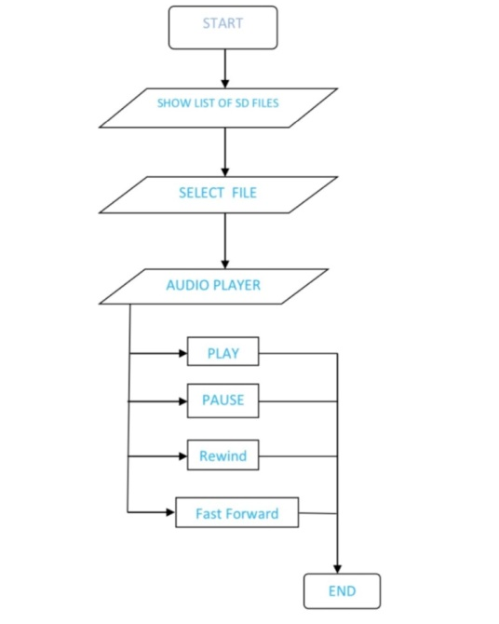
Flowchart

Slide 8
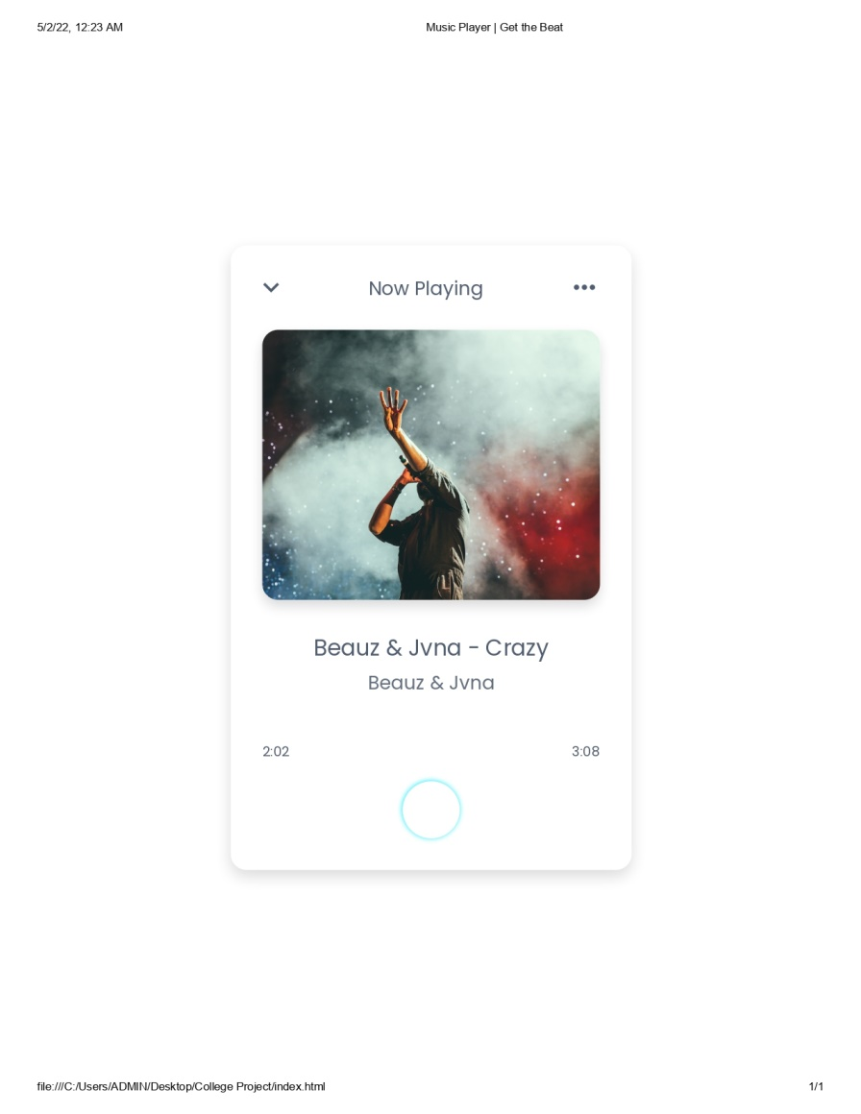
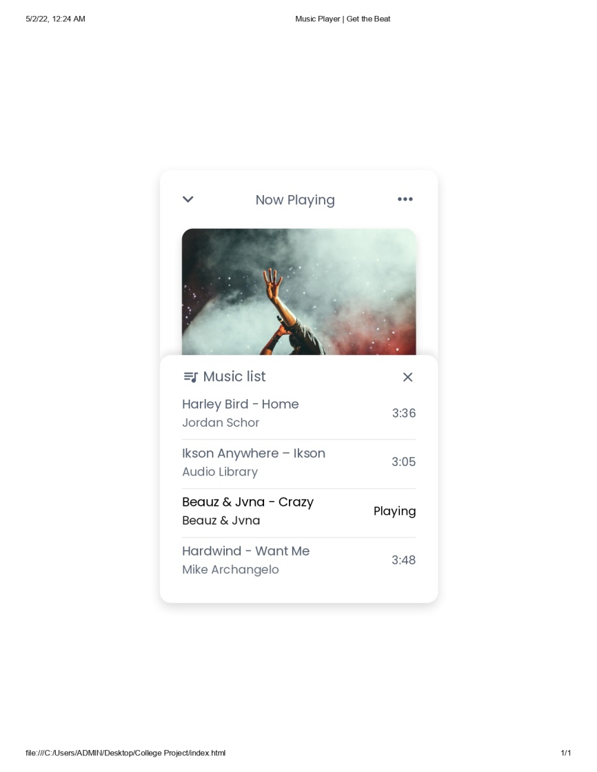
Music Player Interface

Slide 9
Reference
Help from internet, following websites have been used to the compilation of project.
Free Code Camp
Geeks for Geeks
YouTube is used to add songs in Music Player.

Slide 10
THANK YOU

